Slide 1

Multi-Product Supply Chain Optimization
Konstantin Pielmaier
Semester Project
30. October 2025, Zurich
Notes:
Thanks for coming to the midterm presentation of my semester project on the topic of Multi-Product Supply Chain Optimization of Energy Systems supervised by Gabriel.

Slide 2
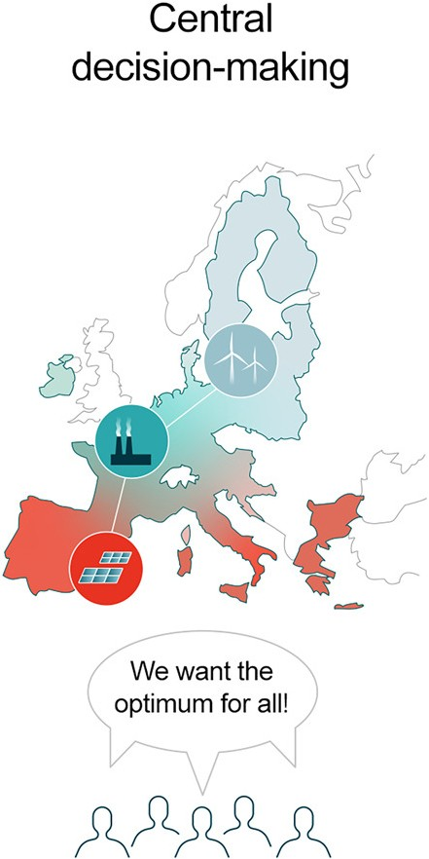
Motivation – Overcoming the central planner approach
minimize total system cost
subject to supply = fixed demand
[1] Yang Shu et al., “Overcoming the central planner approach – Bilevel optimization of the European energy transition,” iScience, vol. 27, no. 7, 2024, https://doi.org/10.1016/j.isci.2024.110168
Notes:
The motivation for my semester project is overcoming the central planner approach frequently used in energy system planning. In most of these optimization models, demand is fixed and supplied at minimum total system cost. This assumes there is a central planner that is capable of making all decision.

Slide 3
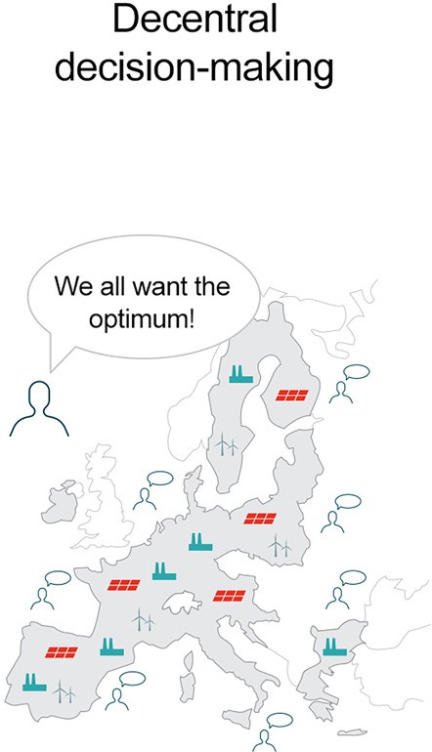






Motivation – Overcoming the central planner approach
Suppliers
competing stakeholders
Consumers
[1] Yang Shu et al., “Overcoming the central planner approach – Bilevel optimization of the European energy transition,” iScience, vol. 27, no. 7, 2024, https://doi.org/10.1016/j.isci.2024.110168
Notes:
However, this does not reflect how modern power markets operate, where stakeholders make decentral decisions.

Slide 4
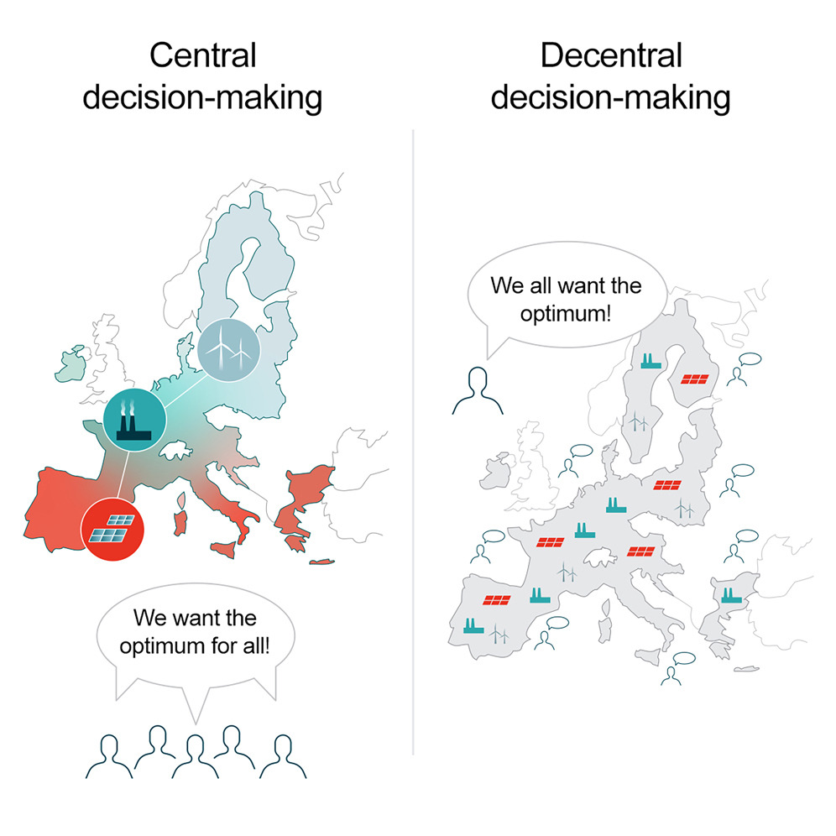
Motivation – Overcoming the central planner approach Bilevel optimization of the European energy transition
Is central planning a good enough approximation?
installed capacity distribution ±40%
average market clearing price +40%
[1] Yang Shu et al., “Overcoming the central planner approach – Bilevel optimization of the European energy transition,” iScience, vol. 27, no. 7, 2024, https://doi.org/10.1016/j.isci.2024.110168
Notes:
Climate change → multinational challenge → joint GHG reduction target
EU carbon/electricity market bilevel optimization → cost-optimal transition pathway
National interest → minimize energy supply cost → competition between countries

Slide 5


Motivation – Overcoming the central planner approach Bilevel optimization of the European energy transition
Limitation:
bilevel → computationally complex
only major strategic decisions at country scale
Outlook:
investigate competing industry stakeholders
better market effects
even more complex
Further:
multi-sector coupling
spatio-temporal resolution
uncertainty
[1] Yang Shu et al., “Overcoming the central planner approach – Bilevel optimization of the European energy transition,” iScience, vol. 27, no. 7, 2024, https://doi.org/10.1016/j.isci.2024.110168
Notes:
Bilevel → single-level MILP

Slide 6
Motivation Overcome central planner
Modelling
Integration
Starting point EnergyScope TD
Framework
Multi-product
supply chain

Slide 7

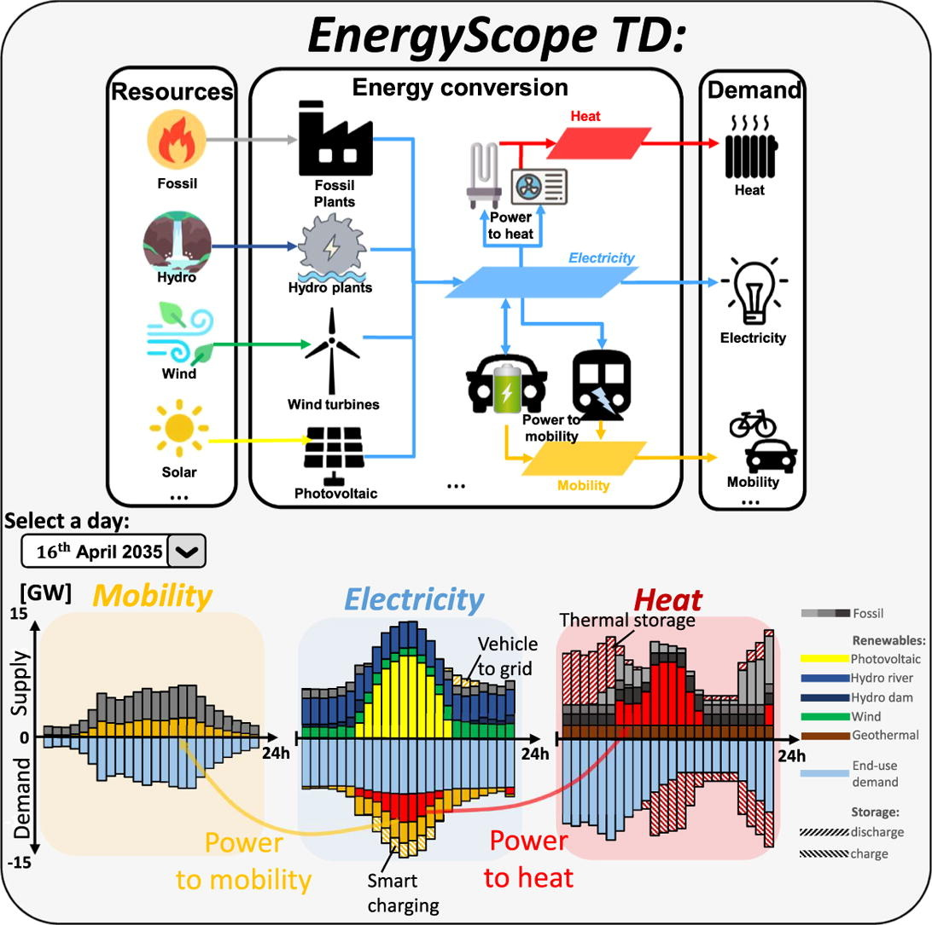
Motivation Overcome central planner
Modelling
Integration
Starting point EnergyScope TD
Framework
Multi-product
supply chain
Notes:
Where to start from?
We already have a model which is able to perform a lot of these tasks (multi-sector coupling, spatio-temporal resolution, uncertainty)
So, we don’t need to build something from the ground up, instead rather use EnergyScope TD as a starting point

Slide 8
Starting point – EnergyScope TD
Objective:
min total system cost
s.t. supply = fixed demand
Layer balance
Multi-sector
coupling
Storage
Implementation:
open-source
linear program (LP)
central planner
Goal: long-term strategic energy system planning
Investment & operation
optimization
Typical day (TD)
→ fast! → uncertainty
Target year (“snapshot”)
Hourly resolution
technologies
[2] G. Limpens, S. Moret, H. Jeanmart, and F. Maréchal, “EnergyScope TD: A novel open-source model for regional energy systems,” Applied Energy, vol. 255, 2019, https://doi.org/10.1016/j.apenergy.2019.113729

Slide 9



Starting point – EnergyScope TD
technologies
Wind
Input Product
Electricity
Output Product
Wind
Resource = Supplier
Wind farm
Technology = Processor
Electric Vehicle
Demand = Consumer
Notes:
What are the corresponding stakeholders in EnergyScope TD?
Resources → e.g. electricity/natural gas grid, uranium, wind
Technologies → processors → e.g. CCGT, nuclear, wind powerplant
Demand → consumers → e.g. electricity load
? → products → electricity, natural gas, uranium, wind

Slide 10

Starting point – EnergyScope TD
technologies
Wind
Input Product
Electricity
Output Product
Electricity
Transport product
Wind
Resource = Supplier
Wind farm
Technology = Processor
Grid
Transporter
Electric Vehicle
Demand = Consumer
Notes:
To incorporate the spatial-resolution…

Slide 11
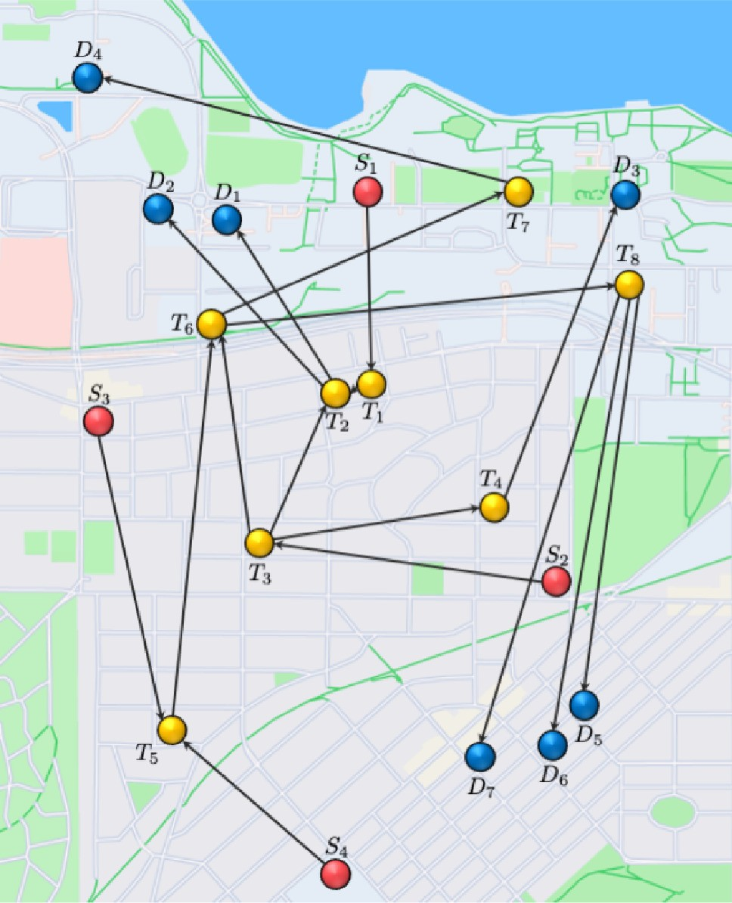
Motivation Overcome central planner
Modelling
Integration
Starting point EnergyScope TD
Framework
Multi-product
supply chain
Notes:
Now that we have identified the stakeholders in EnergyScope TD, we need a market framework that models their competition…

Slide 12
Framework – Multi-Product Supply Chain Optimization
Stakeholder Graph
Wind
Supplier
Wind farm
Processor
Grid
Transporter
Electric Vehicle
Consumer
max profit
s.t. capacity
max profit
s.t. capacity
max profit
s.t. capacity
max profit
s.t. capacity
[3] P. A. Tominac and V. M. Zavala, “Economic properties of multi-product supply chains,” Computers & Chemical Engineering, vol. 145, 2021, https://doi.org/10.1016/j.compchemeng.2020.107157
Notes:
At the university of Wisconsin-Madison in the lab of Professor Zavala, they developed a multi-product supply chain optimization framework using a stakeholder graph. Each stakeholder wants to maximize their own individual profit subject to their capacity constraint.

Slide 13



Framework – Multi-Product Supply Chain Optimization
Coordinated Market Auction
Independent System Operator (ISO)
max social welfare
s.t. balance, capacity
physical primal
Value
resource allocation
bidding information
Capacity
max profit
s.t. capacity
max profit
s.t. capacity
max profit
s.t. capacity
max profit
s.t. capacity
market prices
bidding information
economic dual
min capacity margin
s.t. economic driving force
Notes:
The stakeholders are part of a coordianted market auction. The stakeholders submit their bidding information to the ISO.

Slide 14
ISO (physical primal clearing)
max social welfare
s.t. balance, capacity
bidding information (capacity, value)
resource allocation
Suppliers
max profit
s.t. capacity
Consumers
max profit
s.t. capacity
Transporters
max profit
s.t. capacity
Processors
max profit
s.t. capacity
bidding information (capacity, value)
market clearing prices
ISO (economic dual clearing)
min capacity margin
s.t. economic driving force

Slide 15
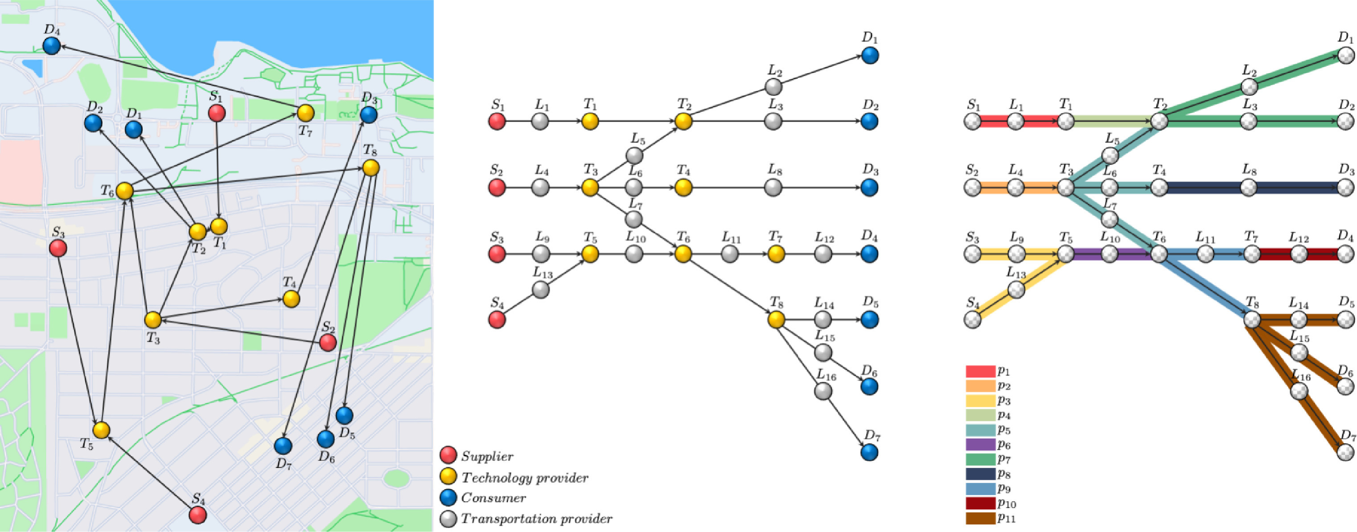

Slide 16
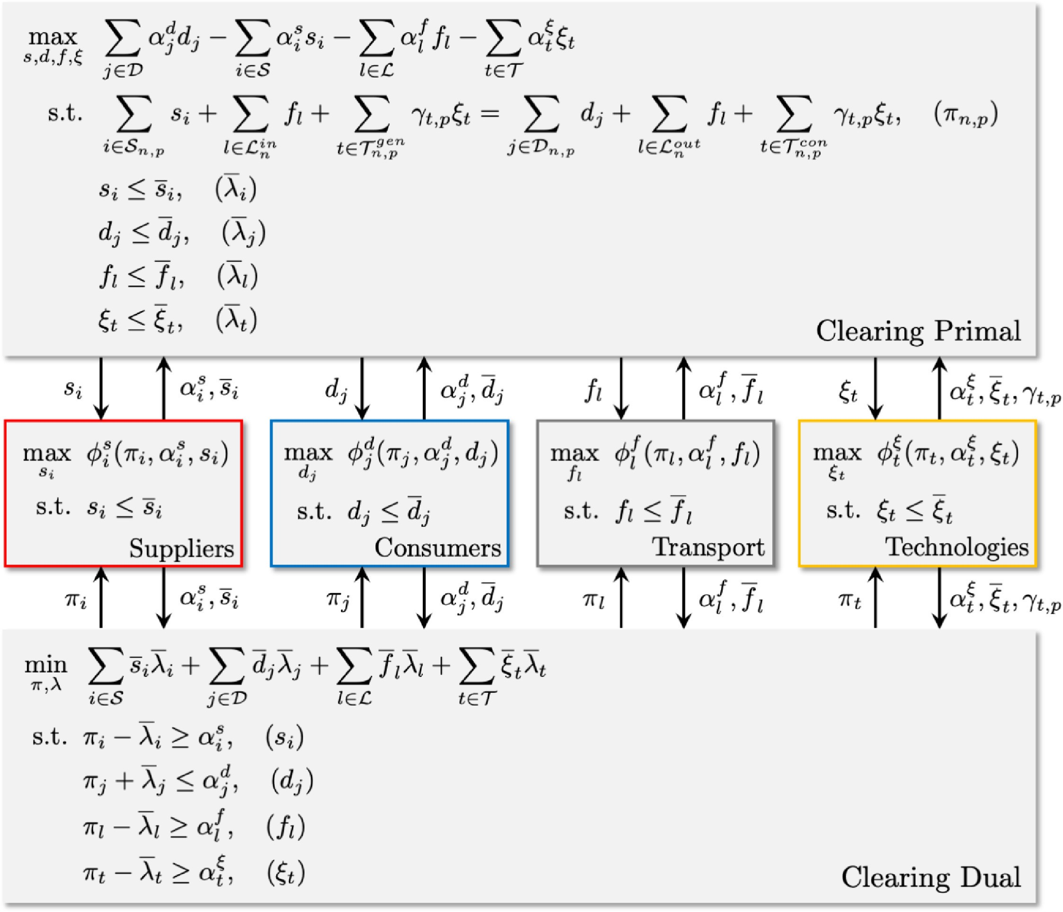
Framework – Multi-Product Supply Chain Optimization
max social welfare
s.t. balance, capacity
max stakeholder profit
s.t. capacity
min capacity margin
s.t. economic
driving force
decentral LP
→ scalable!
[3] P. A. Tominac and V. M. Zavala, “Economic properties of multi-product supply chains,” Computers & Chemical Engineering, vol. 145, 2021, https://doi.org/10.1016/j.compchemeng.2020.107157
Notes:
This is the mathematical formulation. I want you to focus on the three essential parts maximizing social welfare, maximizing stakeholder profit, and minimizing capacity margins. Most importantly, the entire framework is a linear meaning we have a scalable decentral linear program.

Slide 17
Framework – Multi-Product Supply Chain Optimization
Economic
properties
4. Revenue adequacy
3. Competitive
equilibrium
2. No stakeholder
loses money
1. Market clearing
prices are bound
physical
economic
[3] P. A. Tominac and V. M. Zavala, “Economic properties of multi-product supply chains,” Computers & Chemical Engineering, vol. 145, 2021, https://doi.org/10.1016/j.compchemeng.2020.107157
Notes:
Beyond being linear, the market also makes sense. To this end, the Zavala paper mathematically derives important economic properties of the market.

Slide 18
Motivation Overcome central planner
Modelling
Integration
Starting point EnergyScope TD
Framework
Multi-product
supply chain
Notes:
Now that we have a starting point and framework to overcome the central planner assumption…

Slide 19
Modelling – Incorporating EnergyScope TD
Demand
price
[€/MWh]
fixed → $consumer flow=demand$ → economic properties 1, 2, 3, 5
value-of-lost-load (VOLL) → $consumer flow+shed=demand$
linear → social welfare quadratic
quantity
[MW]
Notes:
1 bound prices, 2 positive profits, 3 competitive equilibrium, 4 revenue adequacy, 5 market-activating bids
“This is precisely how coordinated electricity markets operate in the US; here, satisfaction of demands is enforced by defining a bid known as the value-of-lost-load (VOLL).
This bid captures the value of electricity to society and is set to values that are as high as 1000 USD per MWh (the average cost in the US is around 10 USD per MWh).
Effectively, VOLL operates as a market-activating bid that promotes provision of electricity. This is used, for instance, as a mechanism to enforce provision of electricity in remote areas.
Effectively, market activating bids enforce participation but this is done via economic incentives (not by enforcing constraints). This approach preserves the economic properties of the market.”
Alternative stakeholder
Others: d $≤$ demand
Place in Literature – Market Resolution
Game theory → leader-follower relationships
Direct contract negotiation (Stackelberg) → non-linear
Explicit price and quantity → demand-price relationships → non-linear
Auction → market price relationships (Cournot, Bertrand competition)
Stakeholders submit bidding information (capacity, value) → linear
Assumptions
Accurate stakeholder information
No disturbances or failure → deterministic

Slide 20
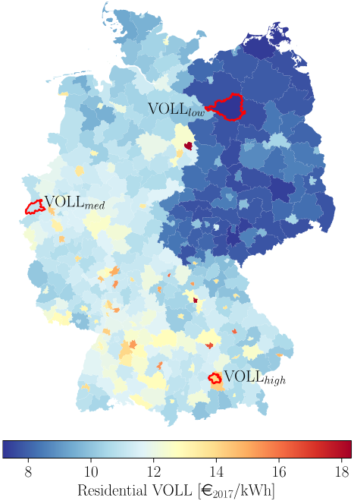
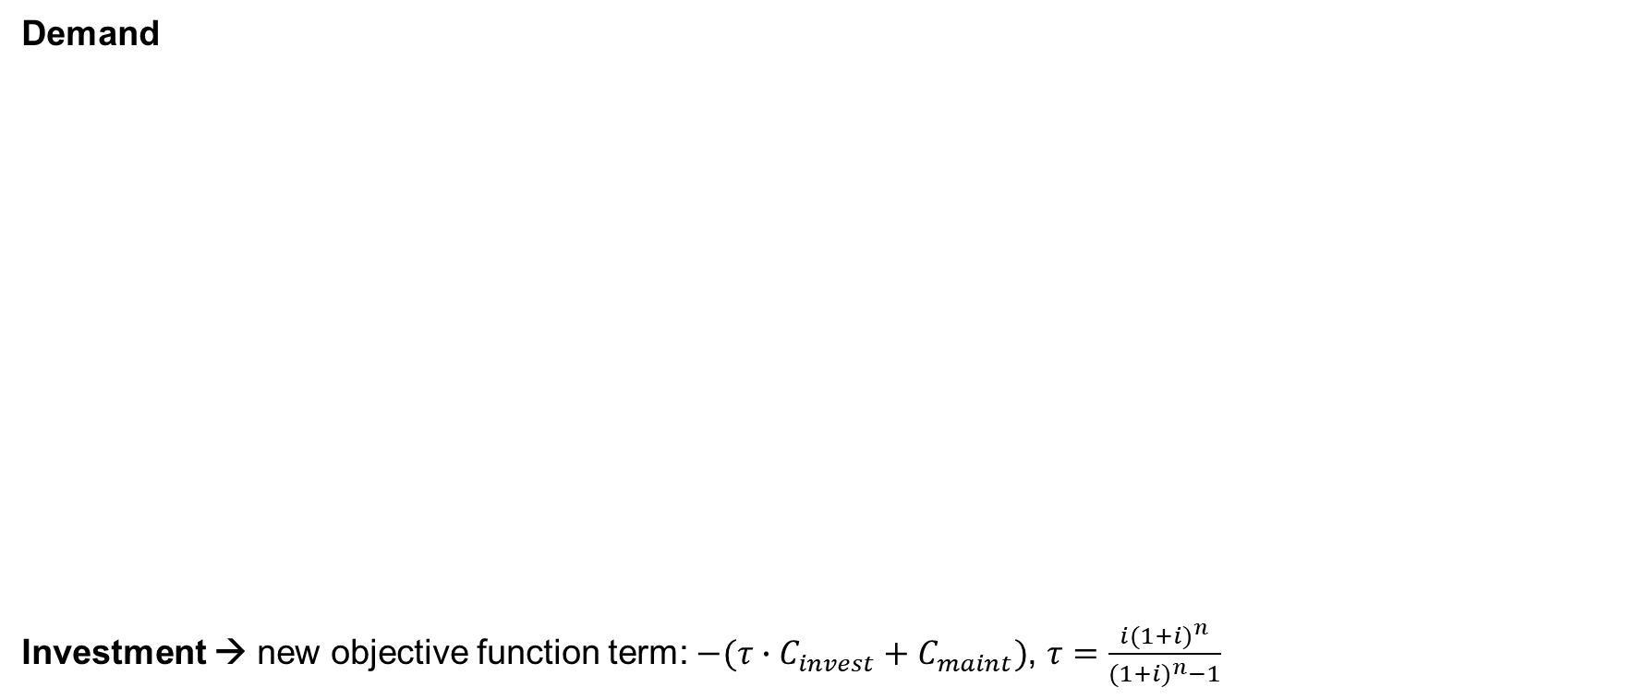
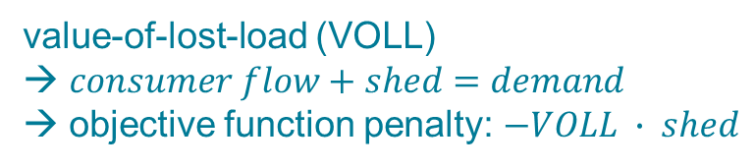
Modelling – Incorporating EnergyScope TD
Demand
Investment → new objective function term: $−(τ∙C_{invest}+C_{maint})$, $τ=\frac{i{(1+i)}^{n}}{{(1+i)}^{n}−1}$
price
[€/MWh]
value-of-lost-load (VOLL)
→ $consumer flow+shed=demand$
objective function penalty: $−VOLL ∙ shed$
quantity
[MW]
[4] F. Kachirayil, D. Huckebrink, V. Bertsch, and R. McKenna, “Trade-offs between system cost and supply security in municipal energy system design: An analysis considering spatio-temporal disparities in the value of lost load,” ESA Working Paper Series, 2024.
Notes:
$VOLL(average Germany)=11.03\frac{€}{MWh}$
Capital Recovery Factor (CRF)

Slide 21
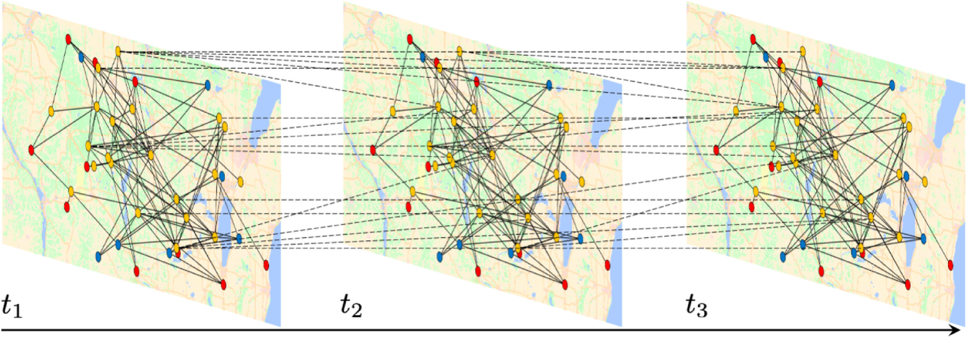

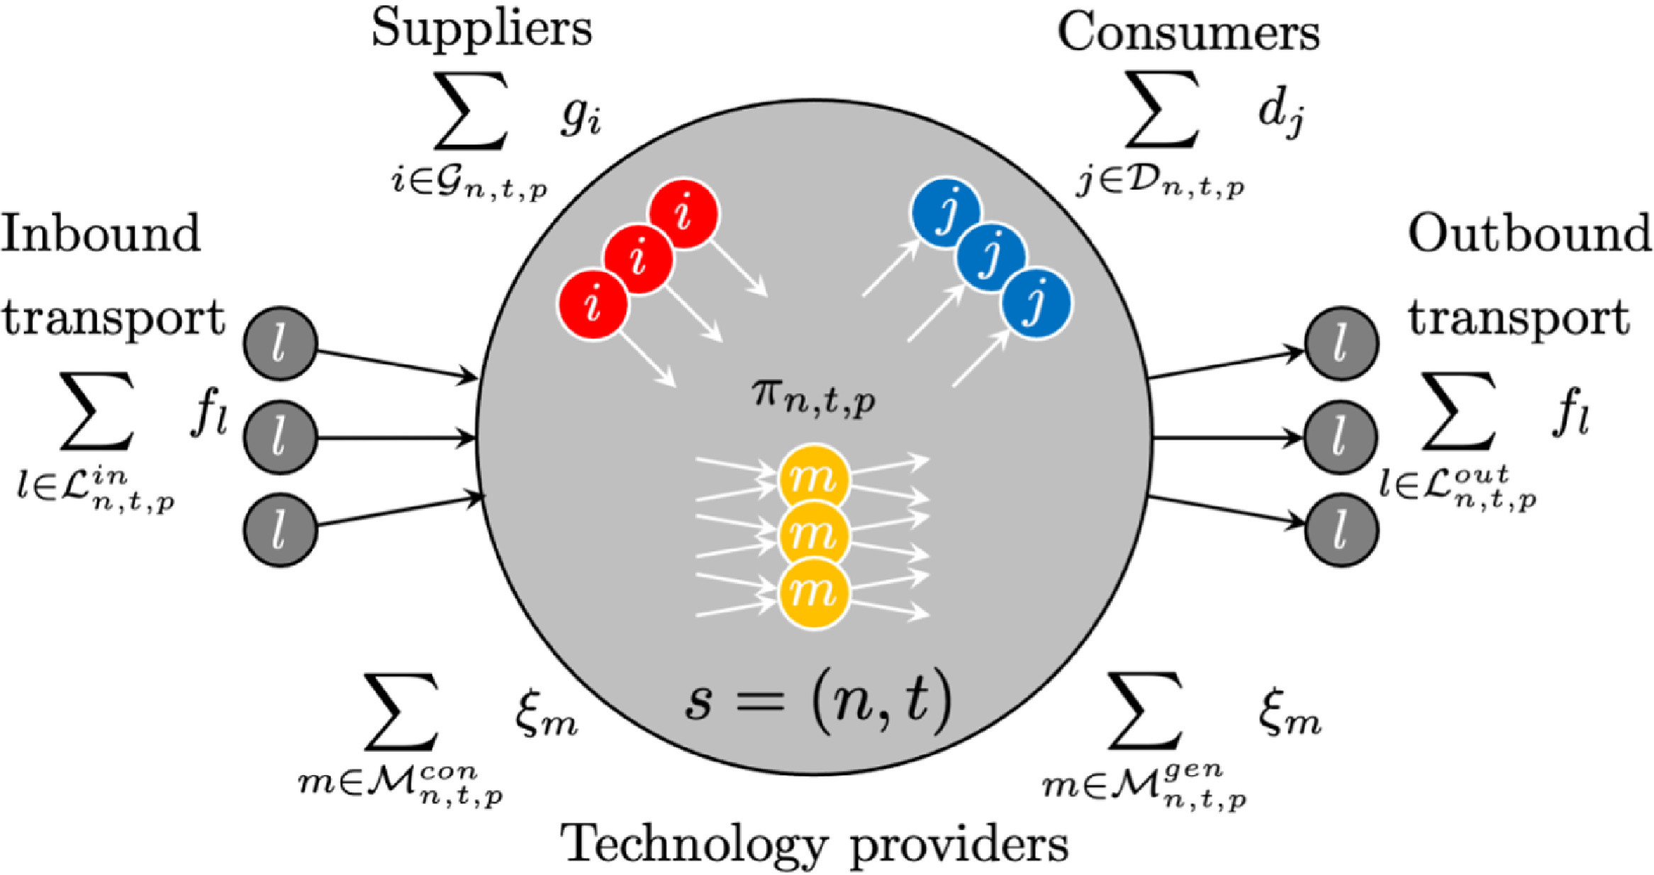
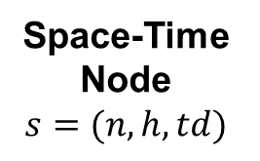
Modelling – Incorporating EnergyScope TD
Time Series
capacity factor
demand
Storage
new stakeholder:
→ temporal transporter
EnergyScope TD
hours h
typical days td
Dynamic
Supply Chain
Space-Time
Node
$$s=(n, h, td)$$
[5] P. A. Tominac, W. Zhang, and V. M. Zavala, “Spatio-temporal economic properties of multi-product supply chains,” Computers & Chemical Engineering, vol. 159, 2022, https://doi.org/10.1016/j.compchemeng.2022.107666
Notes:
Thinking of demand/investment leads us to…

Slide 22
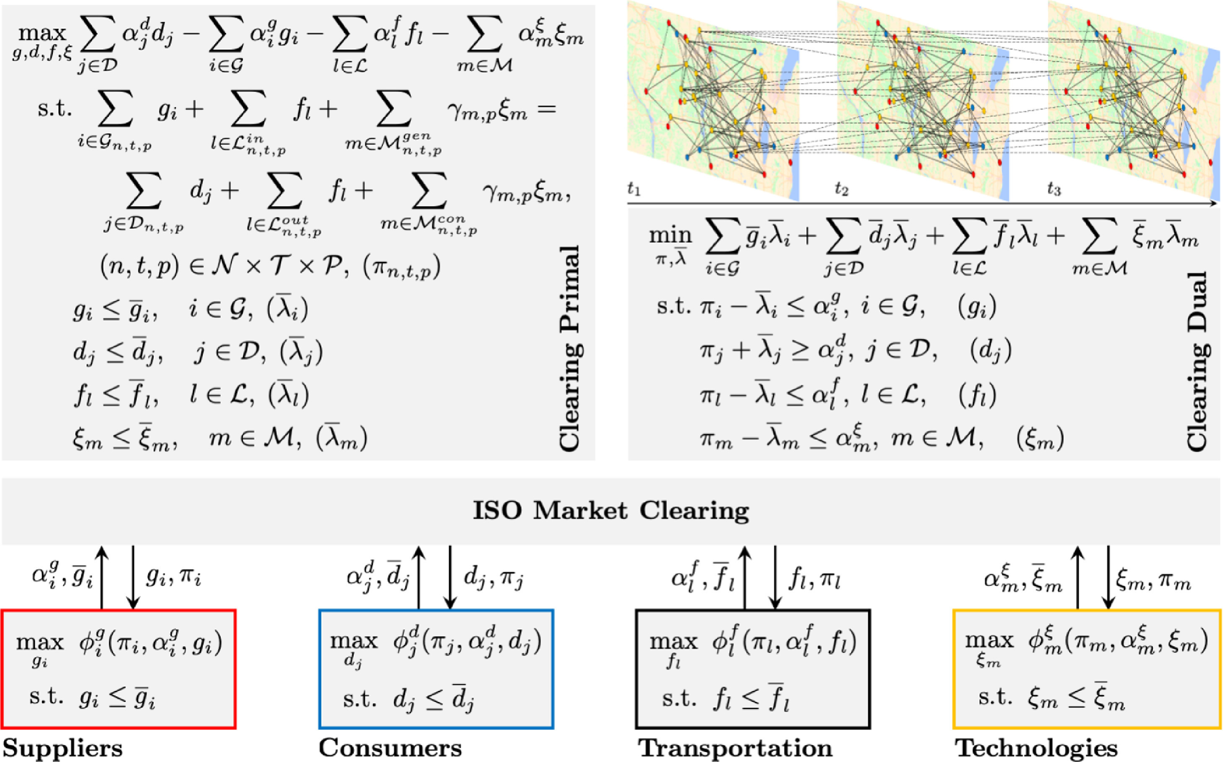
Framework – Spatio-temporal
SI example validation
✓
[5] P. A. Tominac, W. Zhang, and V. M. Zavala, “Spatio-temporal economic properties of multi-product supply chains,” Computers & Chemical Engineering, vol. 159, 2022, https://doi.org/10.1016/j.compchemeng.2022.107666

Slide 23
Motivation Overcome central planner
Modelling
Integration
Starting point EnergyScope TD
Framework
Multi-product
supply chain

Slide 24






Outlook
Bidding information
value
capacity
Storage
daily (battery)
seasonal (PHES)
Case Study
benchmark
validation
Conclusion
viable?
useful?
Notes:
Bidding information → bid value (resource cost, operating cost, etc.) and capacity (actually quite clear?) implicit in EnergyScope TD? → validation, other sources?
Storage → efficiency, periods, state of charge (SoC) → clean/smooth integration tricky
Case study → EnergyScope TD, waste management economy, waste-to-energy (biogas, electricity)
Conclusion → market-activating bids, market price(, investment/operation decision-making)

Slide 25
Thanks for your attention! Feedback/Questions?

Slide 26
References
[1] Yang Shu et al., “Overcoming the central planner approach – Bilevel optimization of the European energy transition,” iScience, vol. 27, no. 7, 2024, https://doi.org/10.1016/j.isci.2024.110168
[2] G. Limpens, S. Moret, H. Jeanmart, and F. Maréchal, “EnergyScope TD: A novel open-source model for regional energy systems,” Applied Energy, vol. 255, 2019, https://doi.org/10.1016/j.apenergy.2019.113729
[3] P. A. Tominac and V. M. Zavala, “Economic properties of multi-product supply chains,” Computers & Chemical Engineering, vol. 145, 2021, https://doi.org/10.1016/j.compchemeng.2020.107157
[4] F. Kachirayil, D. Huckebrink, V. Bertsch, and R. McKenna, “Trade-offs between system cost and supply security in municipal energy system design: An analysis considering spatio-temporal disparities in the value of lost load,” ESA Working Paper Series, 2024.
[5] P. A. Tominac, W. Zhang, and V. M. Zavala, “Spatio-temporal economic properties of multi-product supply chains,” Computers & Chemical Engineering, vol. 159, 2022, https://doi.org/10.1016/j.compchemeng.2022.107666

Slide 27
Framework – Supply Chain Stakeholder Graph
Node-based
Product-based
[3] P. A. Tominac and V. M. Zavala, “Economic properties of multi-product supply chains,” Computers & Chemical Engineering, vol. 145, 2021, https://doi.org/10.1016/j.compchemeng.2020.107157

